Slide 1
Floating Point Representation

Slide 2
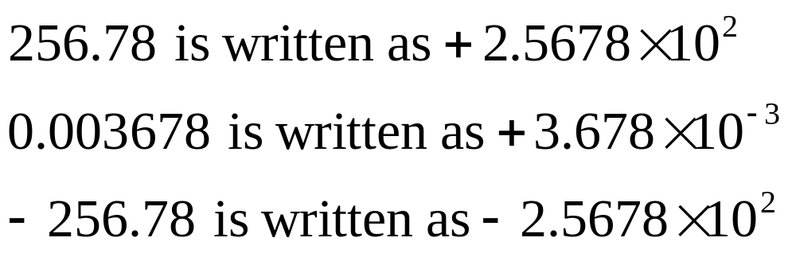
Floating Decimal Point : Scientific Form
http://numericalmethods.eng.usf.edu

Slide 3
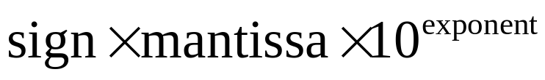
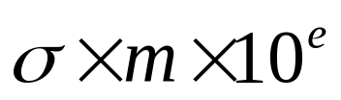

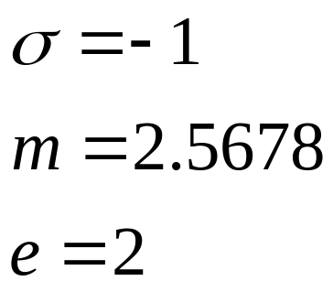
Example
The form is
or
Example: For
http://numericalmethods.eng.usf.edu

Slide 4
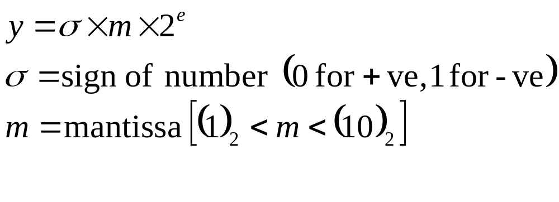
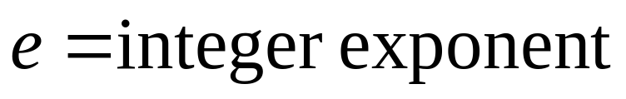
Floating Point Format for Binary Numbers
1 is not stored as it is always given to be 1.
http://numericalmethods.eng.usf.edu

Slide 5
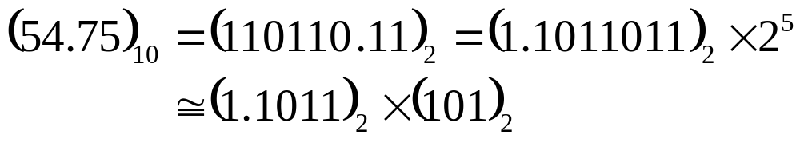
Example
the second bit for the sign of the exponent,
the first bit is used for the sign of the number,
the next four bits for the mantissa, and
the next three bits for the exponent
9 bit-hypothetical word
We have the representation as
0 | 0 | 1 | 0 | 1 | 1 | 1 | 0 | 1
mantissa
exponent
Sign of the number
Sign of the exponent
http://numericalmethods.eng.usf.edu

Slide 6
IEEE 754 Standards for Single Precision Representation

Slide 7
IEEE-754 Floating Point Standard
Standardizes representation of floating point numbers on different computers in single and double precision.
Standardizes representation of floating point operations on different computers.

Slide 8
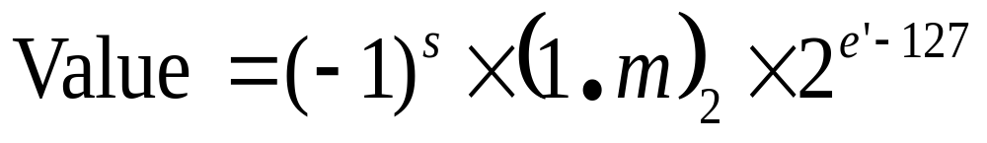
IEEE-754 Format Single Precision
32 bits for single precision
0 | 0 | 0 | 0 | 0 | 0 | 0 | 0 | 0 | 0 | 0 | 0 | 0 | 0 | 0 | 0 | 0 | 0 | 0 | 0 | 0 | 0 | 0 | 0 | 0 | 0 | 0 | 0 | 0 | 0 | 0 | 0
Sign
(s)
Biased
Exponent (e’)
Mantissa (m)

Slide 9
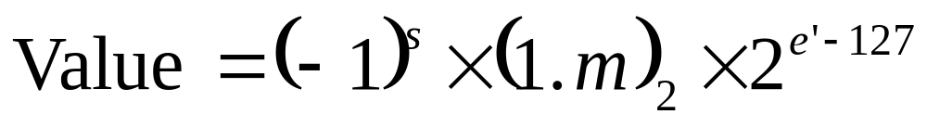
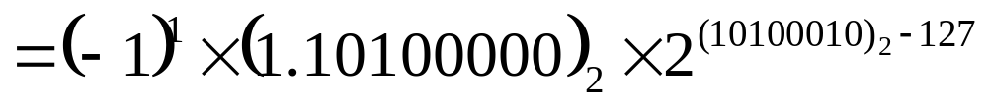
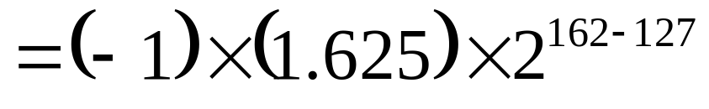
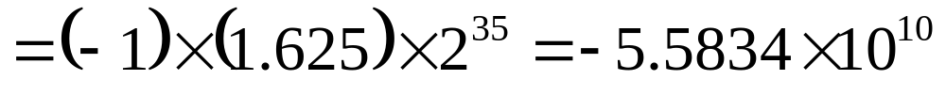
Example#1
1 | 1 | 0 | 1 | 0 | 0 | 0 | 1 | 0 | 1 | 0 | 1 | 0 | 0 | 0 | 0 | 0 | 0 | 0 | 0 | 0 | 0 | 0 | 0 | 0 | 0 | 0 | 0 | 0 | 0 | 0 | 0
Sign
(s)
Biased
Exponent (e’)
Mantissa (m)

Slide 10
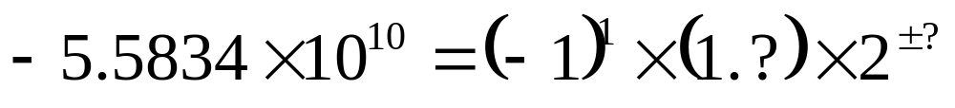
Example#2
Represent -5.5834x10¹⁰ as a single precision floating point number.
? | ? | ? | ? | ? | ? | ? | ? | ? | ? | ? | ? | ? | ? | ? | ? | ? | ? | ? | ? | ? | ? | ? | ? | ? | ? | ? | ? | ? | ? | ? | ?
Sign
(s)
Biased
Exponent (e’)
Mantissa (m)

Slide 11

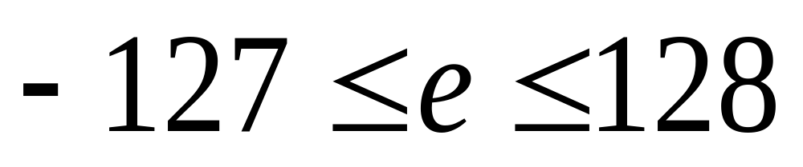
Exponent for 32 Bit IEEE-754
8 bits would represent
Bias is 127; so subtract 127 from representation

Slide 12
The Exponent
The exponent field needs to represent both positive and negative exponents. To do this, a bias is added to the actual exponent in order to get the stored exponent.
For IEEE single-precision floats, this value is 127.
Thus, an exponent of zero means that 127 is stored in the exponent field.
A stored value of 200 indicates an exponent of (200-127), or 73.
Exponents of -127 (all 0s) and +128 (all 1s) are reserved for special numbers.

Slide 13
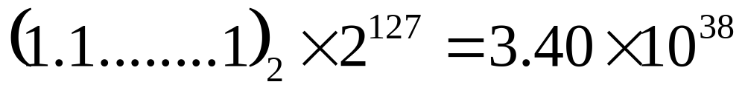
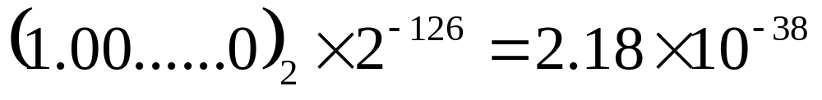
IEEE-754 Format
The largest number by magnitude
The smallest number by magnitude

Slide 14
Internal representation
Floating-point numbers are typically packed into a computer datum as the sign bit, the exponent field, and the significand or mantissa, from left to right.
For the IEEE 754 binary formats (basic and extended) which have extant hardware implementations, they are apportioned as follows:

Slide 15
Floating-point numbers
TypeSignExponentSignificand fieldTotal bitsExponent biasBits precisionNumber of decimal digitsHalf (IEEE 754-2008)1510161511~3.3
Single18233212724~7.2
Double1115264102353~15.9x86 extended precision11564801638364~19.2
Quad11511212816383113~34.0

Slide 16
Type | Sign | Exponent | Significand field | Total bits |  | Exponent bias | Bits precision | Number of decimal digits
Half (IEEE 754-2008) | 1 | 5 | 10 | 16 |  | 15 | 11 | ~3.3
Single | 1 | 8 | 23 | 32 |  | 127 | 24 | ~7.2
Double | 1 | 11 | 52 | 64 |  | 1023 | 53 | ~15.9
x86 extended precision | 1 | 15 | 64 | 80 |  | 16383 | 64 | ~19.2
Quad | 1 | 15 | 112 | 128 |  | 16383 | 113 | ~34.0

Slide 17
While the exponent can be positive or negative, in binary formats it is stored as an unsigned number that has a fixed "bias" added to it.
The exponent range for normalized numbers is [−126, 127] for single precision, [−1022, 1023] for double, or [−16382, 16383] for quad.

Slide 18
Normalized Form
Let's illustrate with an example, suppose that the 32-bit pattern is 1 1000 0001 011 0000 0000 0000 0000 0000, with:
S = 1
E = 1000 0001
F = 011 0000 0000 0000 0000 0000
In the normalized form, the actual fraction is normalized with an implicit leading 1 in the form of 1.F. In this example, the actual fraction is 1.011 0000 0000 0000 0000 0000 = 1 + 1×2^-2 + 1×2^-3 = 1.375D.
The sign bit represents the sign of the number, with S=0 for positive and S=1 for negative number. In this example with S=1, this is a negative number, i.e., -1.375D.

Slide 19
In normalized form, the actual exponent is E-127 (so-called excess-127 or bias-127). This is because we need to represent both positive and negative exponent. With an 8-bit E, ranging from 0 to 255, the excess-127 scheme could provide actual exponent of -127 to 128. In this example, E-127=129-127=2D.
Hence, the number represented is -1.375×2^2=-5.5D.

Slide 20
THE END

